Slide 1
CHAPTER 1: Python Review

Slide 2
Python Syntax
Python is a dynamically-typed language i.e. a variable does not need to be declared with a type and one variable can take on different data types.
Python code is written and executed line by line. We typically separate different instructions with lines but semicolons are also valid.
It uses indentation instead of curly brackets for code blocks.
Python promotes code readability and ease of understanding

Slide 3


Lists and tuples
List
An ordered, mutable collection of elements (the list’s structure can be modified after it has been created)
Has methods for adding and removing elements (append, extend, pop, etc.)
Tuples
An immutable ordered collection of elements (cannot be modified after creation, to put it simply)

Slide 4
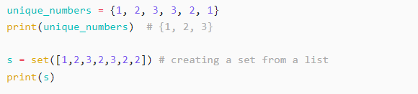

Sets and dictionaries
Sets
An unordered collection of unique elements
Can be created from other iterables like lists, strings and tuples
Dictionaries
Store key-value pairs. The key can only be hashable data types like numbers, strings or tuples.
The values can be any Python object

Slide 5
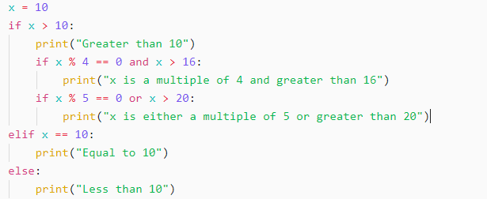
Conditionals
Conditional statements control the flow of execution

Slide 6
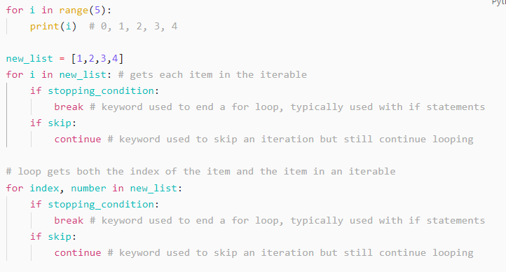
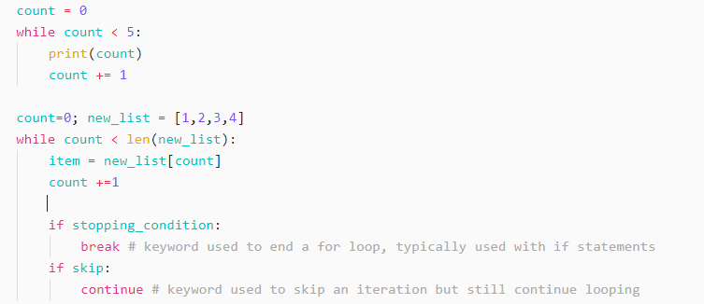
Loops
Python offers for loops and while loops. You can also add an else statement to the end of a loop.
Both loops support break and continue.
For loop
While loop

Slide 7
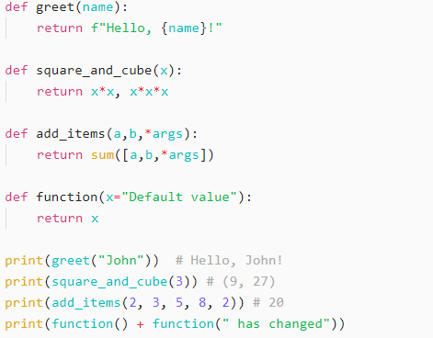
Functions
Functions allow code reusability
Python functions can accept 0 or more arguments and even permit the use of placeholders (*args, **kwargs)
Functions can also return multiple values

Slide 8
Django Installation and Setup

Slide 9
Django Installation
Before getting started, please create a new folder on your computer for this course titled Advanced_OOP. Please take note of where this folder is located.
Now open a terminal and type the pip command to install django: pip install django or python -m pip install django
Once installation has successfully completed, check the version: django-admin --version
If the above check doesn’t work, try
running python -m django-admin --version instead
opening a python shell and importing django

Slide 10
Creating a Django project
After verifying that Django has been successfully installed, create a new folder in the Advanced_OOP folder called Exercises (please respect the casing)
Open a terminal in the Exercises folder created above. We are going to create our first django project here
On the terminal, type django-admin startproject example
Navigate into the example project: cd example
Run the development server: python manage.py runserver
Navigate to http://localhost:8000 on your browser.

Slide 11
Exercises
Create a list of numbers from 1 to 10 and print only even numbers.
Write a function that takes a name as input and returns "Hello, !".
Write a program that asks for a user's age and prints if they are a minor or an adult.
Write a while loop that prints numbers from 5 to 0.
Use the `math` module to compute the square root of a number entered by the user.
Use a regular expression to extract all email addresses from a given text.

Slide 12


